Slide 1
Jared M. Ross
President, League of Southeastern Credit Unions
August 7, 2020

Slide 2
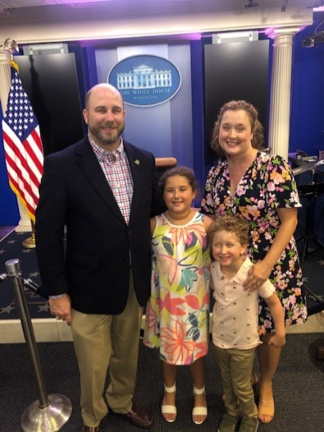
A little about me…
President, LSCU
LSCU: 9 years
Prior to: American Cancer Society
Amazing family
2-Time FSU Graduate
Bachelor of Arts ‘99
Juris Doctor ‘06
HUGE Sports Fan
Did I mention FSU?

Slide 3
Introducing Sydney Rubin
Georgia Senior Director of Governmental Affairs, LSCU
Previously employed at: American Chemistry Council
Double Dawg University of Georgia Graduate
Bachelor of Arts & Bachelor of Science, 2013
Master of Business Administration, 2019
Navigating wedding planning during a pandemic
Loves being active
Philadelphia sports fan (please hold tomatoes)

Slide 4
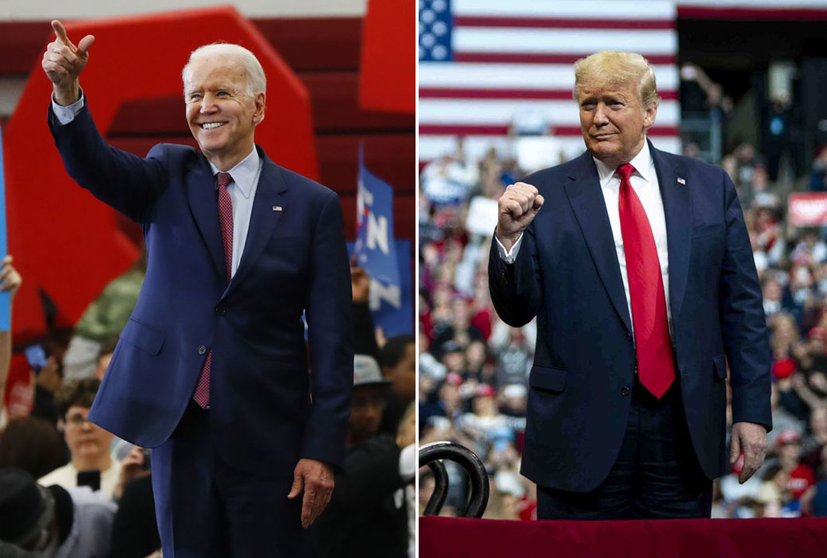

Slide 5
Polling Information
Polling data is taken from Real Clear Politics (realclearpolitics.com)
RCP aggregates polling data from several sources and then averages them to try and give the most accurate polling data available.
None of this information is my own thoughts or data.

Slide 6
2020 Presidential Election

Slide 7
2020 Presidential Election

Slide 8
2020 Presidential Election

Slide 9
2020 Presidential Election

Slide 10
2020 Presidential Election

Slide 11
2020 Presidential Election
So what does all this Presidential polling data mean?

Slide 12
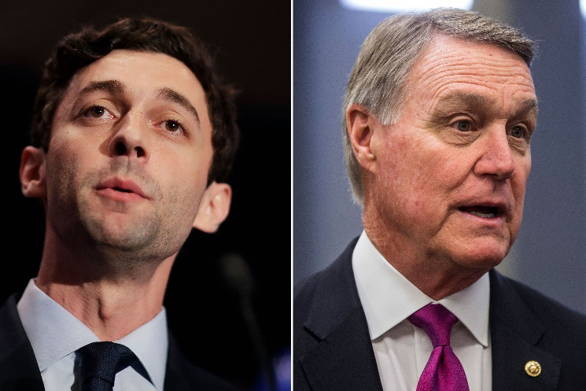
2020 Georgia Senate Elections

Slide 13
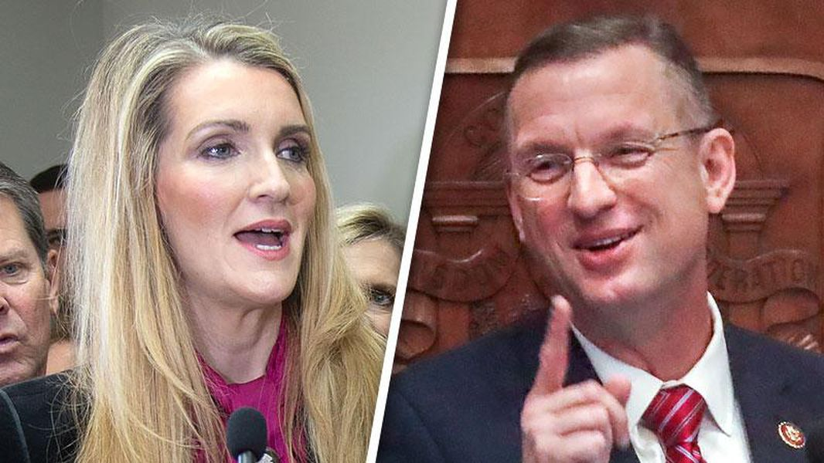
2020 Georgia Senate Elections

Slide 14
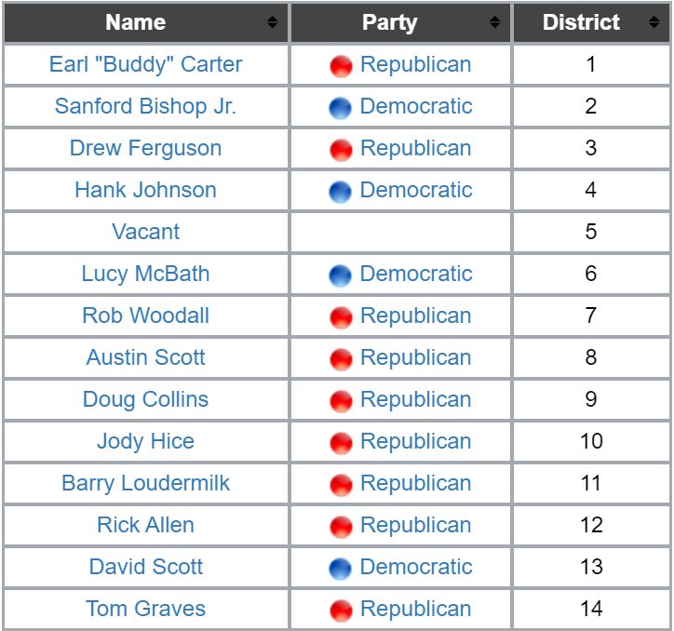
2020 Georgia Congressional Elections
Rob Woodall (GA-7) and Tom Graves (GA-14) are both retiring. Doug Collins (GA-9) is running for US Senate.
Carter, Bishop, Ferguson, Johnson, A. Scott, Hice, Loudermilk, Allen, D. Scott are all likely safe to win their seats again.
State Senator Nikema Williams has been selected by the State Democratic Party to replace John Lewis on the ballot. She will win.
The other 4 seats will be interesting to watch.

Slide 15
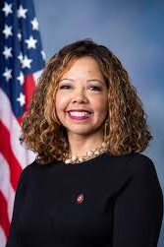
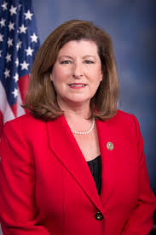
2020 Georgia Congressional Elections
GA Congressional District 6
Lucy McBath
Democratic Incumbent
Karen Handel
Republican
Rated a “Toss Up” by all pundits
Trump won by 1.5 in 2016; Romney by 23 in 2012; McCain by 19 in 2008
McBath beat Handel by 1 in 2018

Slide 16
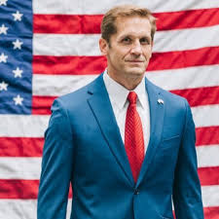
2020 Georgia Congressional Elections
GA Congressional District 7
Rich McCormick, MD
Republican
Carolyn Bourdeaux
Democrat
Rated a “Toss Up” by all pundits
Trump won by 6 in 2016; Romney by 22 in 2012; McCain by 21 in 2008
Woodall beat Bourdeaux by 0.2 in 2018
Democrats expect to flip this seat, but it is a true “Toss Up”

Slide 17
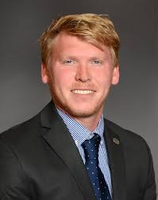
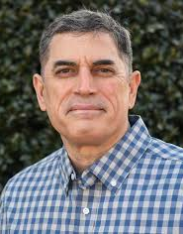
2020 Georgia Congressional Elections
GA Congressional District 9 – GOP Runoff on 8/11
Rep. Matt Gurtler
State Representative
Andrew Clyde
Gun Store Owner
Rated a “Solid Republican” seat by all pundits
Gurtler received 21% to Clyde’s 19% in the 9-person primary
Winner will face Democratic run-off winner (Brooke Siskin or Devin Pandy)
Winner of this primary will succeed Doug Collins, barring a major surprise

Slide 18
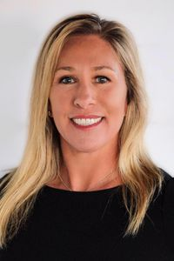
2020 Georgia Congressional Elections
GA Congressional District 14 – GOP Runoff on 8/11
Marjorie Taylor Greene
Business Owner
John Cowan, MD
Neurosurgeon
Rated a “Solid Republican” seat by all pundits
Greene received 40% of the vote to Cowan’s 21%
Since then, Greene has been the subject of a lot of controversy
The winner will face Democrat Kevin Van Ausdal

Slide 19
Dynamics and assumptions independent of electoral outcome
Political / Governmental
Elections in November; but results may not be immediately known.
Credit Unions
System financial condition will be under pressure for foreseeable future, putting pressure on advocacy resources.
Other
Congress will work on COVID-related matters as well as regular order issues.
With Federal, state and local budgets decimated, credit unions will face the most significant threat to the tax status in more than a generation.
Consolidation rates will accelerate.
Changes to consumer needs, demands, and habits will accelerate.
Large gatherings will remain complicated.
Virtual hearings and proxy voting may continue into next year.
The Capitol campus will be inaccessible through the end of the year, and perhaps well into next year.
Public Health / Economic
COVID-19 related public health and economic crises will continue into 2021 and likely beyond.
No vaccine or therapeutic remedy will be widely available for the foreseeable future.
The Federal Reserve will continue to pump money into the economy.
The 2024 presidential campaign starts in January.
Unlike 2008, the financial services industry didn’t start the fire; so post-crisis policy will likely focus on pandemic preparation and health care.

Slide 20
Dynamics and assumptions independent of electoral outcome
Political / Governmental
Elections in November; but results may not be immediately known.
Credit Unions
System financial condition will be under pressure for foreseeable future, putting pressure on advocacy resources.
Other
Congress will work on COVID-related matters as well as regular order issues.
With Federal, state and local budgets decimated, credit unions will face the most significant threat to the tax status in more than a generation.
Consolidation rates will accelerate.
Changes to consumer needs, demands, and habits will accelerate.
Large gatherings will remain complicated.
Virtual hearings and proxy voting may continue into next year.
The Capitol campus will be inaccessible through the end of the year, and perhaps well into next year.
Public Health / Economic
COVID-19 related public health and economic crises will continue into 2021 and likely beyond.
No vaccine or therapeutic remedy will be widely available for the foreseeable future.
The Federal Reserve will continue to pump money into the economy.
The 2024 presidential campaign starts in January.
Unlike 2008, the financial services industry didn’t start the fire; so post-crisis policy will likely focus on pandemic preparation and health care.

Slide 21
Credit union forecast July 8, 2020
 | Actual results |  |  |  | Quarterly results/forecasts |  |  |  |  |  |  |  | Annual forecasts
 | 5 Yr Avg |  | 2019 |  | 2020:1 |  | 2020:2 |  | 2020:3 |  | 2020:4 |  | 2020 |  | 2021
Growth rates:
Savings growth | 6.8% |  | 8.1% |  | 4.3% |  | 8.5% |  | 2.0% |  | 2.0% |  | 17.0% |  | 8.0%
Loan growth | 9.3% |  | 6.5% |  | 0.8% |  | 1.5% |  | 2.0% |  | 1.5% |  | 6.0% |  | 5.0%
Asset growth | 6.9% |  | 7.7% |  | 4.6% |  | 7.7% |  | 1.5% |  | 1.5% |  | 15.0% |  | 7.0%
Membership growth | 3.9% |  | 3.6% |  | 0.8% |  | 0.3% |  | 0.4% |  | 0.3% |  | 1.5% |  | 1.5%
Liquidity:
Loan-to-share ratio** | 82.1% |  | 84.4% |  | 81.1% |  | 76.4% |  | 76.4% |  | 76.0% |  | 76.0% |  | 73.9%
Asset quality:
Delinquency rate** | 0.77% |  | 0.70% |  | 0.63% |  | 0.75% |  | 1.00% |  | 1.50% |  | 1.50% |  | 1.25%
Net charge-off rate* | 0.55% |  | 0.56% |  | 0.58% |  | 0.65% |  | 0.75% |  | 1.00% |  | 0.75% |  | 0.90%
Earnings:
Return on average assets (ROA)* | 0.83% |  | 0.93% |  | 0.53% |  | 0.40% |  | 0.30% |  | 0.15% |  | 0.35% |  | 0.10%
Capital adequacy:
Net worth ratio** | 11.1% |  | 11.4% |  | 11.0% |  | 10.2% |  | 10.1% |  | 10.0% |  | 10.0% |  | 9.5%
*Quarterly data, annualized. **End of period ratio.
Note: Data for the first quarter of 2020 is from CUNA’s Monthly Credit Union Estimates survey data given that NCUA data was not yet available.
Notes:
For our complete economic and credit union forecast check out CUNA’s website at www.cuna.org/economics.
Just highlight here that with fast savings growth and slow loan growth, do forecast a significant increases in CU liquidity:
Loan-to-share ratio will fall to about 76% this year and 74% next year.
However, lower earnings and fast asset growth mean that capital adequacy will also fall:
To about 10.0% this year and 9.5% next year.
Nonetheless, majority of credit unions still well above the 7.0% minimum threshold of NCUA.

Slide 22
Dynamics and assumptions independent of electoral outcome
Political / Governmental
Elections in November; but results may not be immediately known.
Credit Unions
System financial condition will be under pressure for foreseeable future, putting pressure on advocacy resources.
Other
Congress will work on COVID-related matters as well as regular order issues.
With Federal, state and local budgets decimated, credit unions will face the most significant threat to the tax status in more than a generation.
Consolidation rates will accelerate.
Changes to consumer needs, demands, and habits will accelerate.
Large gatherings will remain complicated.
Virtual hearings and proxy voting may continue into next year.
The Capitol campus will be inaccessible through the end of the year, and perhaps well into next year.
Public Health / Economic
COVID-19 related public health and economic crises will continue into 2021 and likely beyond.
No vaccine or therapeutic remedy will be widely available for the foreseeable future.
The Federal Reserve will continue to pump money into the economy.
The 2024 presidential campaign starts in January.
Unlike 2008, the financial services industry didn’t start the fire; so post-crisis policy will likely focus on pandemic preparation and health care.

Slide 23
The Likely Washington Scenarios
Scenario 1
Keep America Great
President Trump wins reelection.
Scenario 2
More Checks on Trump
President Trump wins reelection.
Democrats retain the House.
Republicans retain the Senate, but do not achieve a supermajority.
Democrats retain the House.
Democrats win the Senate, but do not achieve a supermajority.
Scenario 4
Checks on Biden
Biden wins the presidency.
Democrats retain the House.
Republicans retain the Senate, but do not achieve a supermajority.
Scenario 5
Unified Democratic Government
Biden wins the presidency.
Democrats win the Senate, but do not achieve supermajority.
Democrats win the House.

Slide 24
Scenario 1: Keep America Great
Key Figures for Credit Unions
Implications
More executive measures aim to boost economic growth and decrease regulation
Further reform to Dodd-Frank regulations to be industry-friendly
Potential areas of legislative bipartisanship:
Expanded use of Opportunity Zones
Funding major infrastructure package via public-private partnerships
Responsive federal agencies.
The bill will come due on COVID spending.
Speaker of the House Nancy Pelosi
Senate Majority Leader Mitch McConnell
House Financial Services Committee Chairwoman Maxine Waters
Senate Banking Committee Chairman Pat Toomey
President Donald Trump
NCUA Chairman Rodney Hood
CFPB Director Kathy Kraninger

Slide 25
Scenario 2: More checks on Trump
Key Figures for Credit Unions
Implications
Oversight and investigations.
Big battles over nominees.
More pressure on administration’s regulatory relief actions.
Attempts to use Congressional Review Act
Opportunities for bipartisan deals.
The bill will come due on COVID spending.
Speaker of the House Nancy Pelosi
Senate Majority Leader Chuck Schumer
House Financial Services Committee Chairwoman Maxine Waters
Senate Banking Committee Chairman Sherrod Brown
President Donald Trump
NCUA Chairman Rodney Hood
CFPB Director Kathy Kraninger

Slide 26
Scenario 4: Checks on Biden
Key Figures for Credit Unions
Implications
Administration and House will try to pick up where Obama left off.
Regulatory Relief Rollback
Attempts to use Congressional Review Act
Senate will try to hold Biden in check.
Slow confirmation process.
Anticipate several Democratic departures from Congress to administration (speculation)
Sherrod Brown (Labor)
Jack Reed (Defense)
Elizabeth Warren (Treasury)
Kamala Harris (Justice)
Greg Meeks (Commerce / Trade Rep)
Expect a new CFPB Director
The bill will come due on COVID spending.
Speaker of the House Nancy Pelosi
Senate Majority Leader Mitch McConnell
House Financial Services Committee Chairwoman Maxine Waters
Senate Banking Committee Chairman Pat Toomey
President Joe Biden
NCUA Chairman Todd Harper
CFPB Director

Slide 27
Scenario 5: Unified Democratic government
Key Figures for Credit Unions
Implications
Administration and House will try to pick up where Obama left off.
Regulatory Relief Rollback
Attempts to use Congressional Review Act
DEI
Service to underserved
Anticipate fewer Senate Democratic departures from Congress to administration than if Dems were in minority
Expect a new CFPB Director
The bill will come due on COVID spending.
Speaker of the House Nancy Pelosi
Senate Majority Leader Chuck Schumer
House Financial Services Committee Chairwoman Maxine Waters
Senate Banking Committee Chairman Sherrod Brown
President Joe Biden
NCUA Chairman Todd Harper
CFPB Director

Slide 28
Four observations
The biggest tax fights in recent memory are on the horizon, driven by state and federal budget situations, not just banker angst.
In a Biden administration, we will be on defensive against regulatory burden again.
We are as well positioned as we have ever been from an advocacy perspective, but there are more uncontrollable variables than we generally have to manage.
Charter enhancements need to align with policy goals of those in power.

Slide 29
QUESTIONS?
Jared Ross
jared.ross@lscu.coop
850.322.6956

Slide 30
Jared M. Ross
President, League of Southeastern Credit Unions
August 7, 2020

