Slide 1
2022 Political Update
Georgia Federal/State Elections, Factors to Watch, Potential Shifts and Credit Union Issues on the Radar

Slide 2
Georgia Electorate Turnout

Slide 3
Georgia Federal Races
 | US Sen Warnock | US Rep Carter-1 | US Rep Bishop-2 | US Rep Ferguson-3 | US Rep Johnson-4 | US Rep Williams-5 | US Rep 6-Open | US Rep Bourdeaux (McBath)-7*
Votes in incumbent’s party | 731,594 | 80,757 | 58,805 | 116,489 | 84,773 | 90,932 | 33,801 | 53,269
Votes for opposite party | 1,178,625 | 45,052 | 62,010 | 32,207 | 28,002 | 21,540 | 113,553 | 45,374
 | US Rep A. Scott-8 | US Rep Clyde-9 | US Rep 10-Open | US Rep Loudermilk-11 | US Rep Allen-12 | US Rep D. Scott-13 | US Rep Taylor-Greene-14
Votes in incumbent’s party | 90,426 | 118,509 | 112,165 | 99,073 | 81,151 | 92,139 | 103,841
Votes for opposite party | 30,655 | 21,434 | 37,710 | 33,470 | 44,537 | 22,131 | 26,885
*US Rep. Bourdeaux was defeated by US Rep. Lucy McBath who opted to run for the 7th seat instead given the redistricting changes, which left her 6th seat open.

Slide 4
November General Elections
No Victory Lap for Top Races
  888,000 vs 300,000
Already Decided: 121 state seats
Impact of Redistricting:
  4 incumbent losses and 1 federal
  1 tight(er) federal race: US Rep. Sandford Bishop
Constitutional Seat Surprises
  Republican
  Democrats
Shifting Leadership (US House, State Senate)

Slide 5
State Legislature: Balance of Power

Slide 6

Factors to Watch
GOP Messaging vs Democrat Organization
  What Equates to the Highest Voter Turnout?
  And Which Party Can Appeal to the Split-Ticket Swing-Voter?
Damage Control in Both Parties
External Factors:
  Inflation
  Former President Trump
  Supreme Court

Slide 7
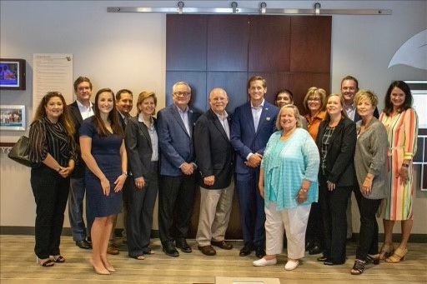
Potential Changes of Note to Credit Unions
Federal Seats of Note
  Rich McCormick and Mike Collins
Potential Shifts in Leadership
  Governor – Will be Tight
  Lt. Governor – Will be New
Shift in State Chairmanships
  Senate Leadership
  Senate Banking
  House Ways and Means?
New State Legislators: 51 Open Seats, 4 Losses Already

Slide 8
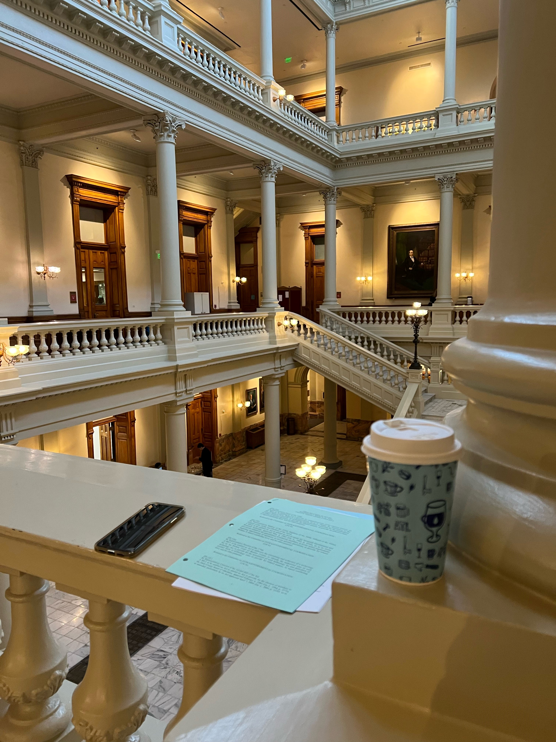
State Issues of Note for Credit Unions
Taxation
  Intangible Tax
CRA
PACE Loans
Real Estate Closings
  Remote Online Notary Hang-Over?
Interchange
Inflationary Reactions: Credit Reporting, Overdraft, Housing Issues

