Slide 1
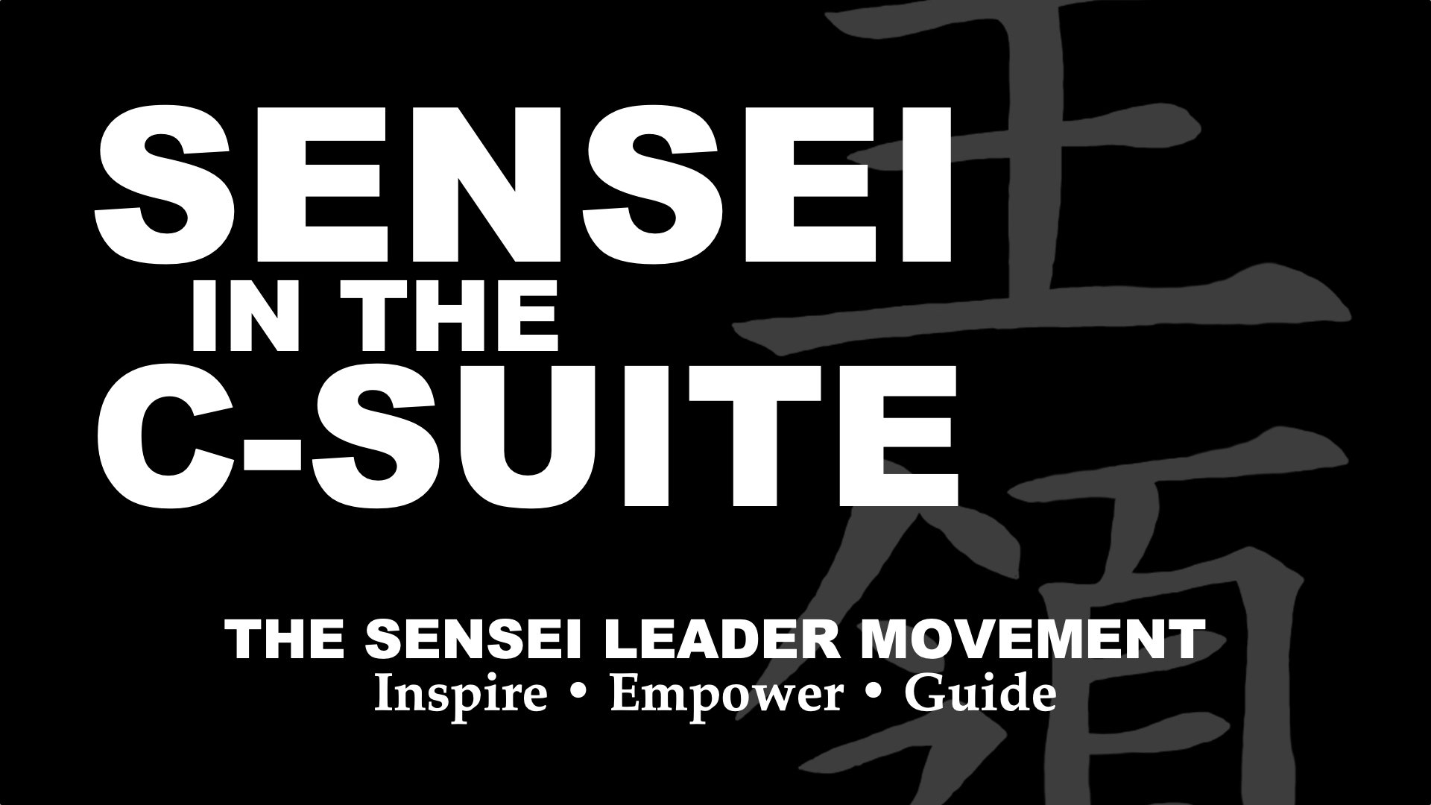
THESENSEILEADER.COM
© Black Belt Mindset Productions LLC
Notes:
CREDENTIALS–Two time dropout and drug abuser…Aren’t you glad you paid me to be here today?

Slide 2
“When the people are not in awe of your majesty––
Then great majesty has been achieved”
~Lao Tzu
THESENSEILEADER.COM
© Black Belt Mindset Productions LLC
Notes:
How do you inspire? COURAGE-COMPASSION-WISDOM

Slide 3
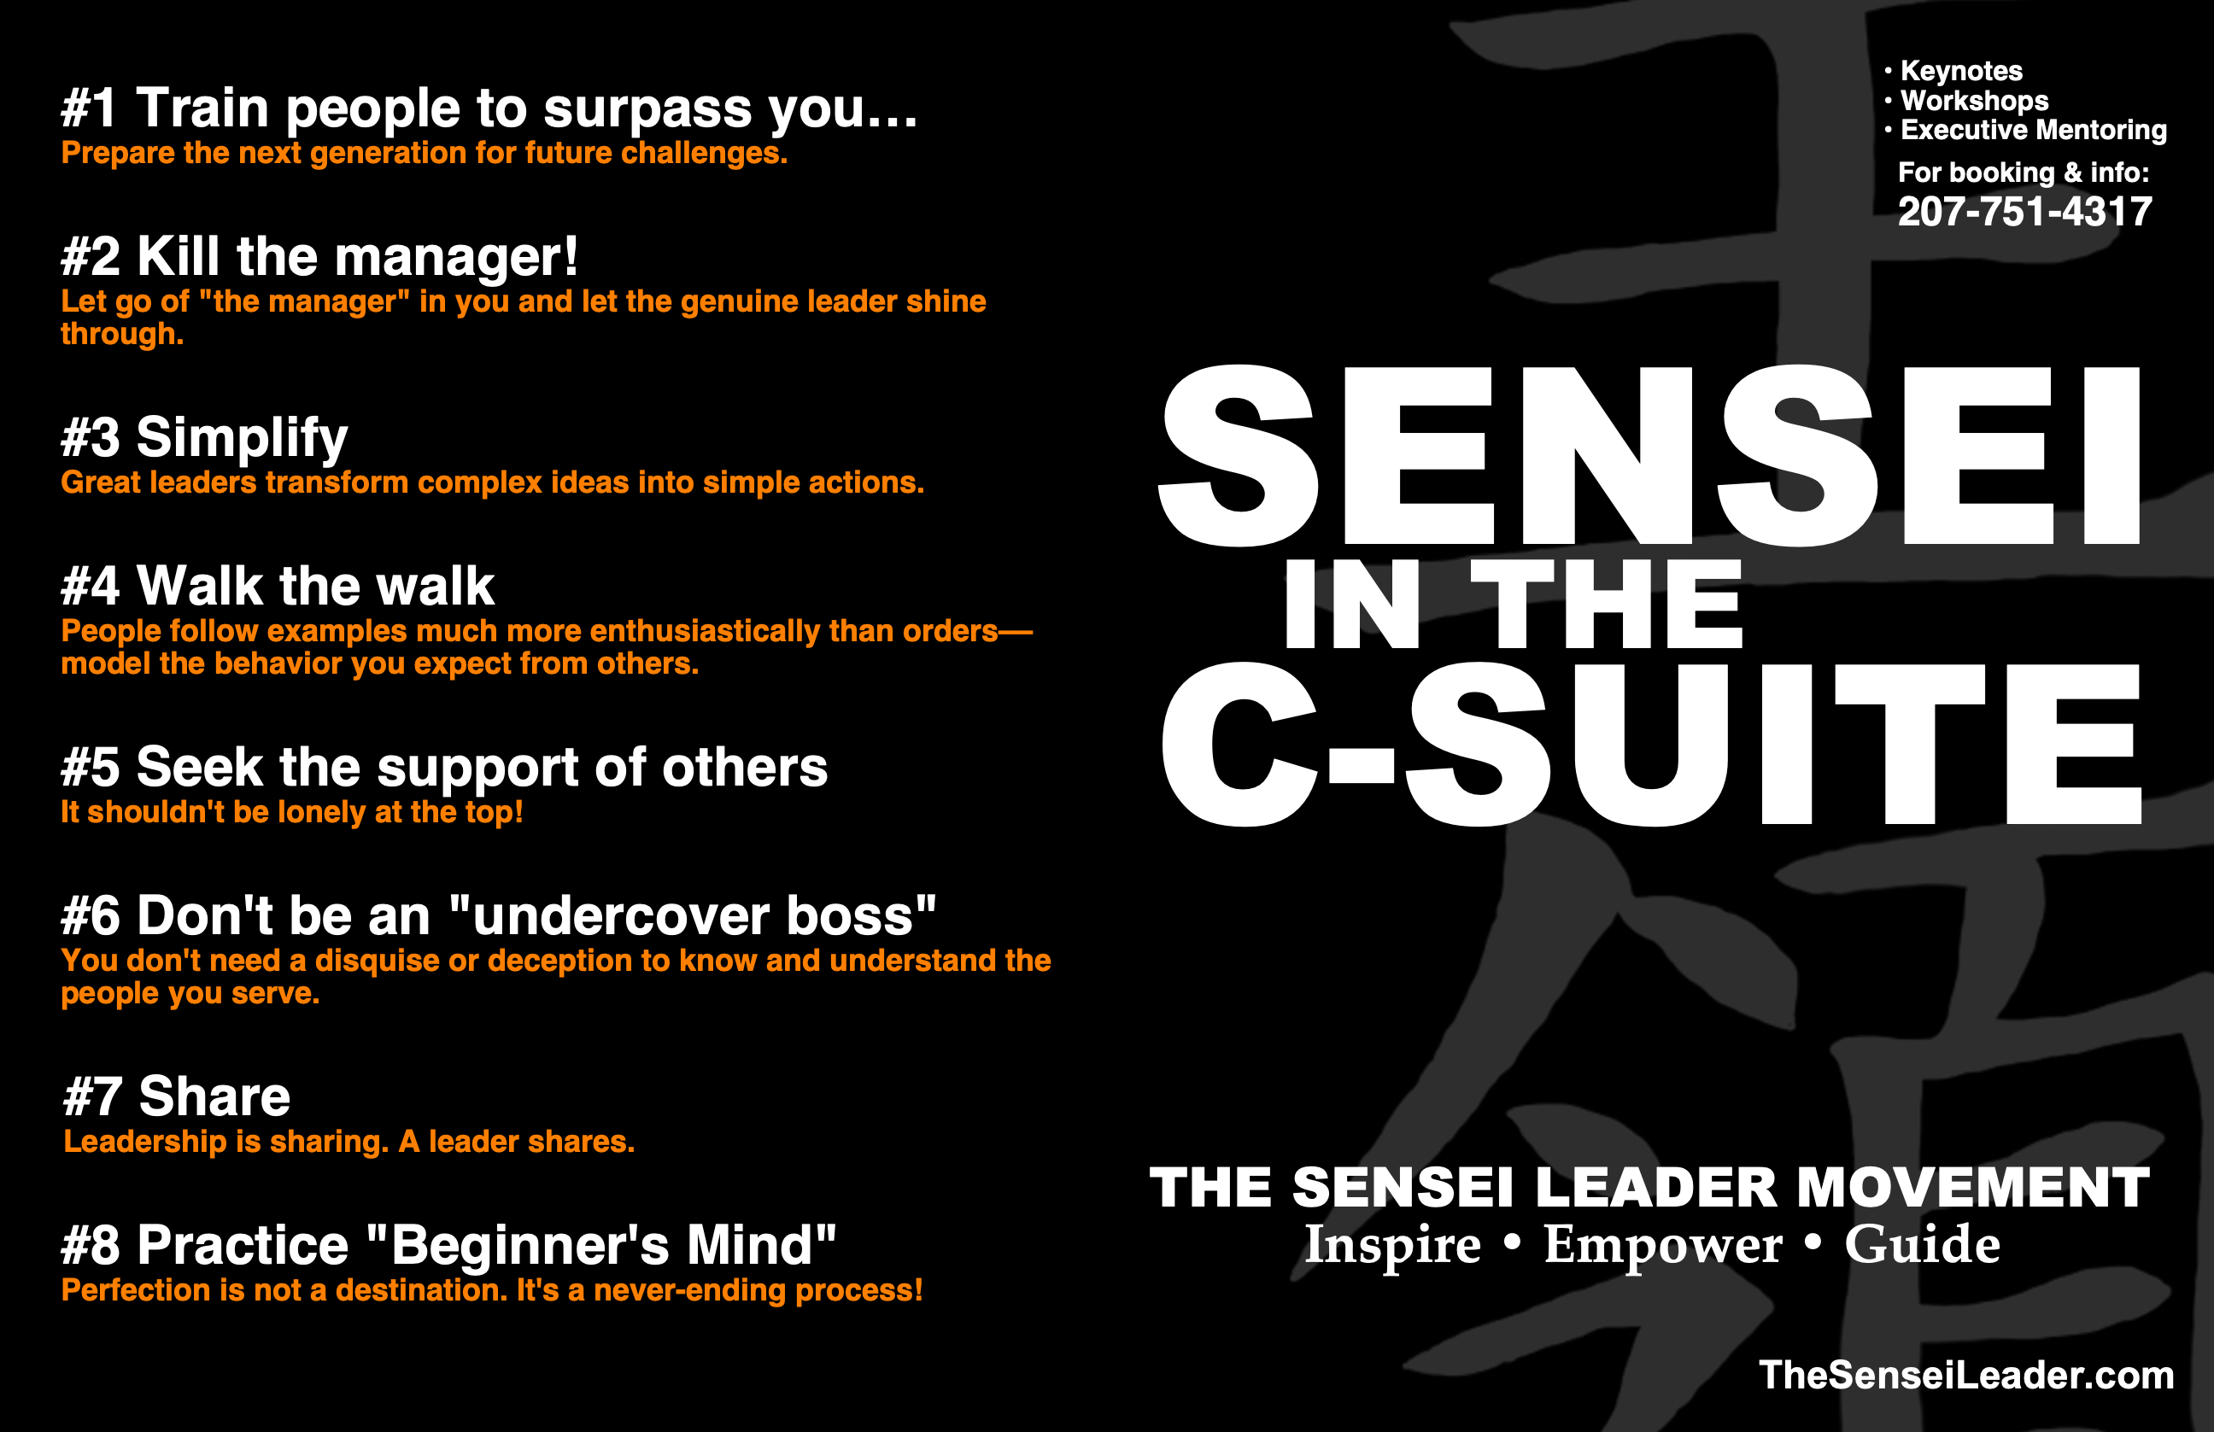
THESENSEILEADER.COM
© Black Belt Mindset Productions LLC
Notes:
How do you inspire? COURAGE-COMPASSION-WISDOM

Slide 4
ROI - RTL
THESENSEILEADER.COM
© Black Belt Mindset Productions LLC

Slide 5

1. Train people to surpass you…
THESENSEILEADER.COM
© Black Belt Mindset Productions LLC

Slide 6
“A leader is best when the people barely know he exists…
THESENSEILEADER.COM
© Black Belt Mindset Productions LLC
Notes:
How do you inspire? COURAGE-COMPASSION-WISDOM

Slide 7
“When his work is done,
his aim fulfilled they will say…
THESENSEILEADER.COM
© Black Belt Mindset Productions LLC
Notes:
How do you inspire? COURAGE-COMPASSION-WISDOM

Slide 8
“…we did it ourselves!”
~Lao Tzu
THESENSEILEADER.COM
© Black Belt Mindset Productions LLC
Notes:
How do you inspire? COURAGE-COMPASSION-WISDOM

Slide 9
2. Kill “the manager”!
THESENSEILEADER.COM
© Black Belt Mindset Productions LLC

Slide 10
“the manager” | THE LEADER
motivate | Inspire
delegate | Empower
drive | Guide
THESENSEILEADER.COM
© Black Belt Mindset Productions LLC

Slide 11
3. Simplify
THESENSEILEADER.COM
© Black Belt Mindset Productions LLC

Slide 12
“People desire honesty and integrity but will follow simple and clear leaders, even if they lack honesty and integrity. It seems hard to believe, but just look at history for evidence.”
~Tony Bridwell
Inc. March 2016
THESENSEILEADER.COM
© Black Belt Mindset Productions LLC

Slide 13
Autonomy
Mastery
Purpose
~Dan Pink
THESENSEILEADER.COM
© Black Belt Mindset Productions LLC

Slide 14
4. Walk the Walk
THESENSEILEADER.COM
© Black Belt Mindset Productions LLC

Slide 15
“People follow examples
much more enthusiastically
than orders.”
THESENSEILEADER.COM
© Black Belt Mindset Productions LLC
Notes:
How do you inspire? COURAGE-COMPASSION-WISDOM

Slide 16
5. Seek the support of others
THESENSEILEADER.COM
© Black Belt Mindset Productions LLC

Slide 17
Should it really be
lonely at the top?
THESENSEILEADER.COM
© Black Belt Mindset Productions LLC
Notes:
How do you inspire? COURAGE-COMPASSION-WISDOM

Slide 18
6. Don’t be an “undercover boss”
THESENSEILEADER.COM
© Black Belt Mindset Productions LLC

Slide 19
Trust
Compassion
Stability
Hope
~Gallup
THESENSEILEADER.COM
© Black Belt Mindset Productions LLC
Notes:
How do you inspire? COURAGE-COMPASSION-WISDOM

Slide 20
7. Share
THESENSEILEADER.COM
© Black Belt Mindset Productions LLC

Slide 21
Power
Authority
Recognition
THESENSEILEADER.COM
© Black Belt Mindset Productions LLC
Notes:
How do you inspire? COURAGE-COMPASSION-WISDOM

Slide 22
“A general officer who will invariably assume the responsibility for failure, whether he deserves it or not…
THESENSEILEADER.COM
© Black Belt Mindset Productions LLC

Slide 23
“…and invariably give the credit for success to others, whether they deserve it or not…
THESENSEILEADER.COM
© Black Belt Mindset Productions LLC

Slide 24
“…will achieve outstanding success.”
~General George S. Patton
THESENSEILEADER.COM
© Black Belt Mindset Productions LLC

Slide 25
8. Practice “Beginner’s Mind”
THESENSEILEADER.COM
© Black Belt Mindset Productions LLC

Slide 26
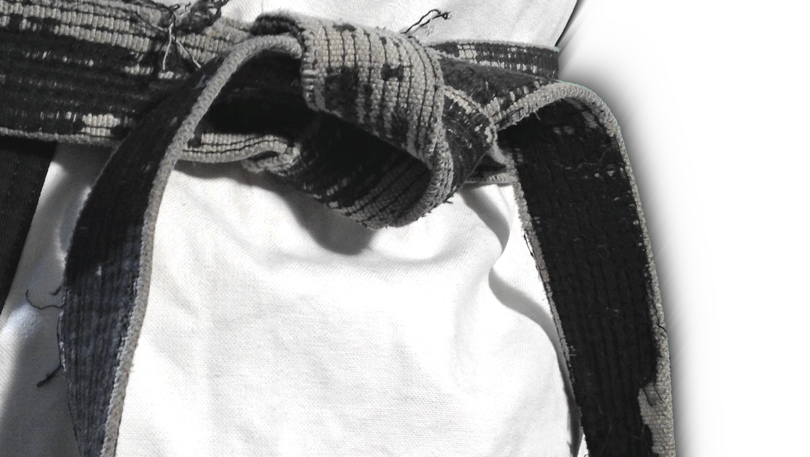

“Perfection is NOT a destination…
…it’s a never-ending process!”
THESENSEILEADER.COM
© Black Belt Mindset Productions LLC
Notes:
Beginner’s Mind Belt story …

Slide 27
