Slide 1
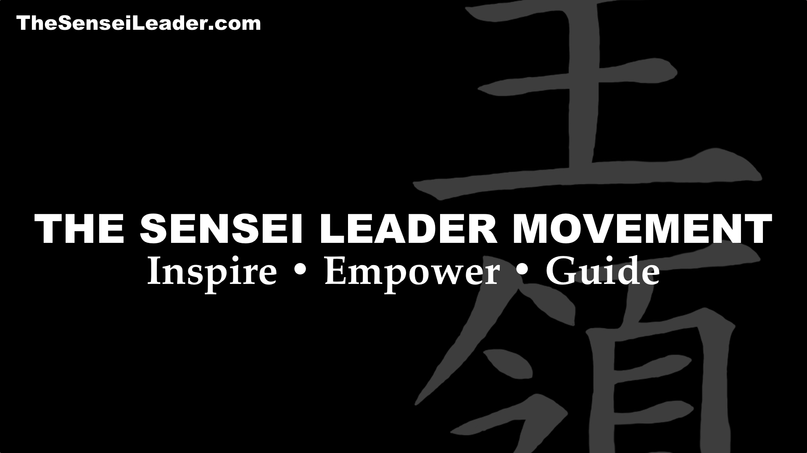

Your slide deck has an audio narration.
If you’d like to hear the narration, be sure to turn up speakers or use headphones.
Click to start the program and advance slides.

Slide 2


Slide 3
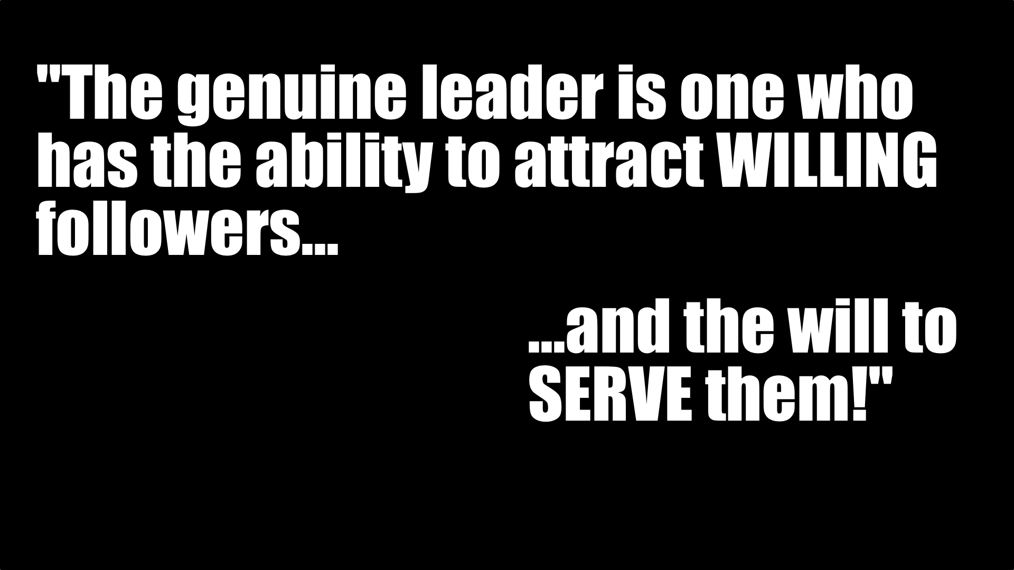
THESENSEILEADER.COM
© Black Belt Mindset Productions LLC

Slide 4
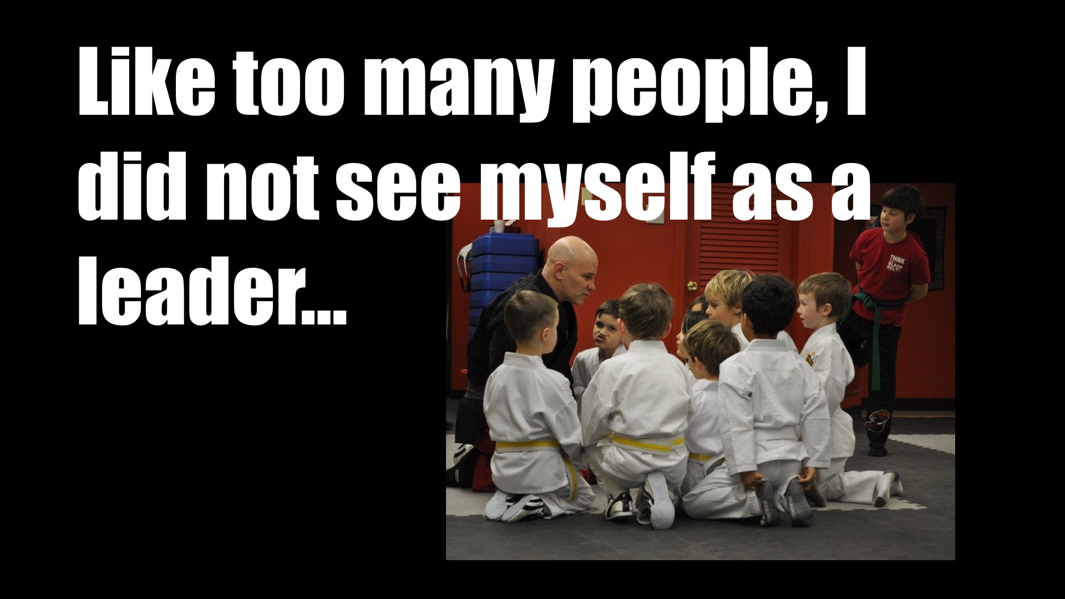
THESENSEILEADER.COM
© Black Belt Mindset Productions LLC

Slide 5
SENSEI
THESENSEILEADER.COM
© Black Belt Mindset Productions LLC

Slide 6
“If your actions inspire others to dream more, learn more, do more and become more…
You are a leader.”
~John Quincy Adams
or Dolly Parton!
THESENSEILEADER.COM
© Black Belt Mindset Productions LLC

Slide 7

COURAGE
THESENSEILEADER.COM
© Black Belt Mindset Productions LLC

Slide 8
“I learned that courage was not the absence of fear, but the triumph over it. The brave man is not he who does not feel afraid, but he who conquers that fear.”
~Nelson Mandela
THESENSEILEADER.COM
© Black Belt Mindset Productions LLC

Slide 9
COMPASSION
THESENSEILEADER.COM
© Black Belt Mindset Productions LLC

Slide 10
The good folks at Gallup asked 10,000 people what qualities they want and feel are most important in leaders.
No big surprises—here’s what they want:
Compassion
Trust
Stability
Hope
THESENSEILEADER.COM
© Black Belt Mindset Productions LLC

Slide 11
Respect
THESENSEILEADER.COM
© Black Belt Mindset Productions LLC

Slide 12
Undercover Boss
THESENSEILEADER.COM
© Black Belt Mindset Productions LLC

Slide 13
WISDOM
THESENSEILEADER.COM
© Black Belt Mindset Productions LLC

Slide 14
“Wisdom is knowledge and experience…
…tempered by awareness.”
~from THE SENSEI LEADER
THESENSEILEADER.COM
© Black Belt Mindset Productions LLC

Slide 15
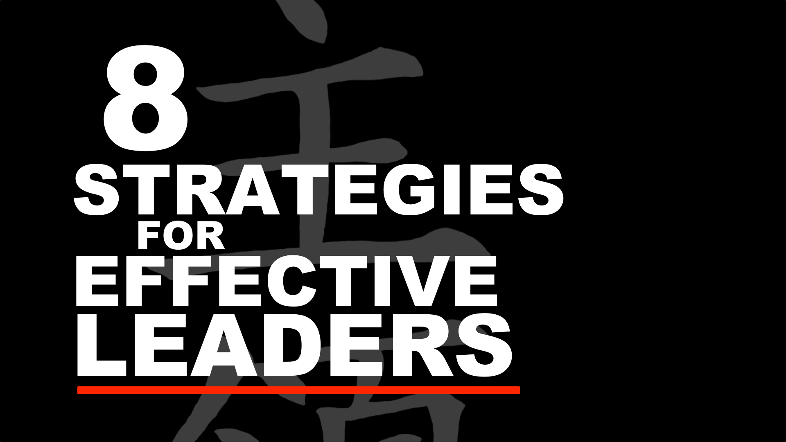
TheSenseiLeader.com
ThatBlackBeltGuy.com

Slide 16
ROI - RTL
THESENSEILEADER.COM
© Black Belt Mindset Productions LLC

Slide 17
Respect
Trust
Loyalty
THESENSEILEADER.COM
© Black Belt Mindset Productions LLC

Slide 18
1. Never limit yourself to one leadership style…
THESENSEILEADER.COM
© Black Belt Mindset Productions LLC

Slide 19
“In primary freedom, one utilizes all ways and is bound by none …
~Bruce Lee
THESENSEILEADER.COM
© Black Belt Mindset Productions LLC

Slide 20
… and likewise uses any techniques or means which serves one’s end.”
~Bruce Lee
THESENSEILEADER.COM
© Black Belt Mindset Productions LLC

Slide 21
2. Be tough-
yet compassionate…
THESENSEILEADER.COM
© Black Belt Mindset Productions LLC

Slide 22
Gordon
THESENSEILEADER.COM
© Black Belt Mindset Productions LLC

Slide 23
3. Commit yourself to personal & professional Mastery…
THESENSEILEADER.COM
© Black Belt Mindset Productions LLC

Slide 24
Autonomy
Mastery
Purpose
~Dan Pink
THESENSEILEADER.COM
© Black Belt Mindset Productions LLC

Slide 25
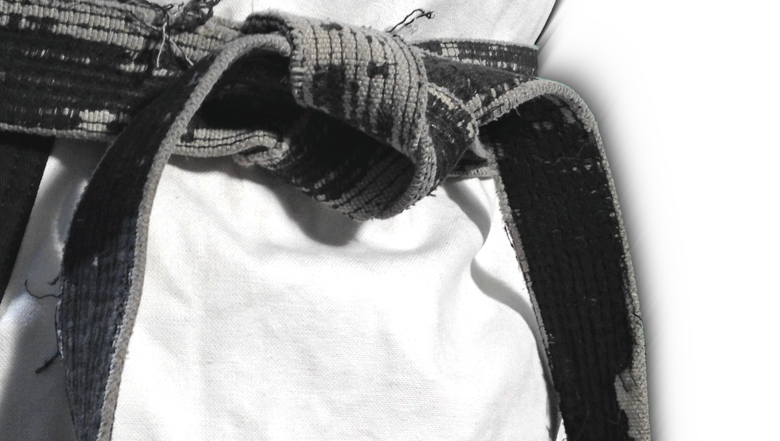
“Perfection is NOT a destination…
…it’s a never-ending process!”
THESENSEILEADER.COM
© Black Belt Mindset Productions LLC

Slide 26
Marcus
THESENSEILEADER.COM
© Black Belt Mindset Productions LLC

Slide 27
4. Be confident, yet humble.
Lead by example…
THESENSEILEADER.COM
© Black Belt Mindset Productions LLC

Slide 28
“A leader leads by example––
not by force.”
~Sun Tzu
THESENSEILEADER.COM
© Black Belt Mindset Productions LLC

Slide 29
“When the people are not in awe of your majesty–– then great majesty has been achieved.”
~Lao Tzu
THESENSEILEADER.COM
© Black Belt Mindset Productions LLC

Slide 30
5. Be flexible, adaptable and
comfortable with uncertainty…
THESENSEILEADER.COM
© Black Belt Mindset Productions LLC

Slide 31
What is going to happen––tomorrow?
THESENSEILEADER.COM
© Black Belt Mindset Productions LLC

Slide 32
6. Be a skilled communicator…
THESENSEILEADER.COM
© Black Belt Mindset Productions LLC

Slide 33
“Who you are as a leader becomes reality in the minds and hearts of others through what you say, how you say it…”
~THE SENSEI LEADER
THESENSEILEADER.COM
© Black Belt Mindset Productions LLC

Slide 34
7. Be a dedicated teacher, coach and mentor…
THESENSEILEADER.COM
© Black Belt Mindset Productions LLC

Slide 35
“Leaders don’t create followers…
…they create more leaders.”
~Tom Peters
THESENSEILEADER.COM
© Black Belt Mindset Productions LLC

Slide 36
“… they started calling me–– Master.”
~THE SENSEI LEADER
THESENSEILEADER.COM
© Black Belt Mindset Productions LLC

Slide 37
8. Lead by sharing…
THESENSEILEADER.COM
© Black Belt Mindset Productions LLC

Slide 38
“The wise man does not lay up his own treasures …
THESENSEILEADER.COM
© Black Belt Mindset Productions LLC

Slide 39
“The more he gives to others, the more he has for his own.”
~Lao Tzu
THESENSEILEADER.COM
© Black Belt Mindset Productions LLC

Slide 40
“You grow as a leader, and as a person, in direct proportion to what you’re willing to share with others.”
~THE SENSEI LEADER
THESENSEILEADER.COM
© Black Belt Mindset Productions LLC

Slide 41
“Stay DOWN!”
THESENSEILEADER.COM
© Black Belt Mindset Productions LLC

Slide 42
“Leadership is sharing––
a leader shares.”
~THE SENSEI LEADER
THESENSEILEADER.COM
© Black Belt Mindset Productions LLC

Slide 43
SL 15+
EFFECTIVE LEADERS
THESENSEILEADER.COM
© Black Belt Mindset Productions LLC

Slide 44
COURAGE
THESENSEILEADER.COM
© Black Belt Mindset Productions LLC

Slide 45
Results as of June, 2018
A1) There is no growth without risk.
Strongly agree
Agree
Disagree
Strongly disagree
THESENSEILEADER.COM
© Black Belt Mindset Productions LLC

Slide 46
Results as of June, 2018
A1) There is no growth without risk.
THESENSEILEADER.COM
© Black Belt Mindset Productions LLC

Slide 47
A2) Challenges and obstacles are the best ways to test my talents…
Strongly agree
Agree
Disagree
Strongly disagree
THESENSEILEADER.COM
© Black Belt Mindset Productions LLC

Slide 48
A2) Challenges and obstacles are the best ways to test my talents…
THESENSEILEADER.COM
© Black Belt Mindset Productions LLC

Slide 49
A3) It takes genuine courage to be creative and innovative.
Strongly agree
Agree
Not necessarily
Disagree
Strongly disagree
THESENSEILEADER.COM
© Black Belt Mindset Productions LLC

Slide 50
A3) It takes genuine courage to be creative and innovative.
THESENSEILEADER.COM
© Black Belt Mindset Productions LLC

Slide 51
A4) Doing the right thing is always the most important consideration…
Strongly agree
Agree
There are exceptions
Disagree
Strongly disagree
THESENSEILEADER.COM
© Black Belt Mindset Productions LLC

Slide 52
A4) Doing the right thing is always the most important consideration…
THESENSEILEADER.COM
© Black Belt Mindset Productions LLC

Slide 53
A5) Which of these statements best defines COURAGE?
Absence of fear
Ability to manage fear
Act despite fear
Hide fear from others
THESENSEILEADER.COM
© Black Belt Mindset Productions LLC

Slide 54
A5) Which of these statements best defines COURAGE?
THESENSEILEADER.COM
© Black Belt Mindset Productions LLC

Slide 55
COMPASSION
THESENSEILEADER.COM
© Black Belt Mindset Productions LLC

Slide 56
B1) I am comfortable expressing my feelings frankly with others.
Always
Usually
Sometimes
Never
THESENSEILEADER.COM
© Black Belt Mindset Productions LLC

Slide 57
B1) I am comfortable expressing my feelings frankly with others.
THESENSEILEADER.COM
© Black Belt Mindset Productions LLC

Slide 58
B2) …it is important to solicit input from key players at all levels.
Strongly agree
Agree
Disagree
Strongly disagree
THESENSEILEADER.COM
© Black Belt Mindset Productions LLC

Slide 59
B2) …it is important to solicit input from key players at all levels.
THESENSEILEADER.COM
© Black Belt Mindset Productions LLC

Slide 60
B3) How often do you openly recognize people for a job well done?
Never
Rarely
Sometimes
Frequently
Daily
THESENSEILEADER.COM
© Black Belt Mindset Productions LLC

Slide 61
B3) How often do you openly recognize people for a job well done?
THESENSEILEADER.COM
© Black Belt Mindset Productions LLC

Slide 62
B4) I get as much satisfaction from the success of others…
Strongly agree
Agree
About the same
Disagree
Strongly disagree
THESENSEILEADER.COM
© Black Belt Mindset Productions LLC

Slide 63
B4) I get as much satisfaction from the success of others…
THESENSEILEADER.COM
© Black Belt Mindset Productions LLC

Slide 64
B5) How well to you know your co-workers and subordinates?
Know each personally
Well professionally, not personally
Some well, others…
Know little outside of work
THESENSEILEADER.COM
© Black Belt Mindset Productions LLC

Slide 65
B5) How well to you know your co-workers and subordinates?
THESENSEILEADER.COM
© Black Belt Mindset Productions LLC

Slide 66
WISDOM
THESENSEILEADER.COM
© Black Belt Mindset Productions LLC

Slide 67
C1) I am usually well aware of how my words & actions are perceived…
Usually
Sometimes surprised
Sometimes taken wrong
They just don’t get me!
THESENSEILEADER.COM
© Black Belt Mindset Productions LLC

Slide 68
C1) I am usually well aware of how my words & actions are perceived…
THESENSEILEADER.COM
© Black Belt Mindset Productions LLC

Slide 69
C2) When is it appropriate to relax personal & professional development?
When goal is reached
When “successful”
Approaching goal
Never
THESENSEILEADER.COM
© Black Belt Mindset Productions LLC

Slide 70
C2) When is it appropriate to relax personal & professional development?
THESENSEILEADER.COM
© Black Belt Mindset Productions LLC

Slide 71
C3) Personal & professional development are inseparable.
Strongly agree
Agree
Disagree
Strongly disagree
THESENSEILEADER.COM
© Black Belt Mindset Productions LLC

Slide 72
C3) Personal & professional development are inseparable.
THESENSEILEADER.COM
© Black Belt Mindset Productions LLC

Slide 73
C4) How important is emotional intelligence & inter-personal skill…?
Hard skills more important
Equally important
Soft skills more important
THESENSEILEADER.COM
© Black Belt Mindset Productions LLC

Slide 74
C4) How important is emotional intelligence & inter-personal skill…?
THESENSEILEADER.COM
© Black Belt Mindset Productions LLC

Slide 75
C5) Ideas and vision must always flow from the top down.
Strongly agree
Agree
Disagree
Strongly disagree
THESENSEILEADER.COM
© Black Belt Mindset Productions LLC

Slide 76
C5) Ideas and vision must always flow from the top down.
THESENSEILEADER.COM
© Black Belt Mindset Productions LLC

Slide 77
TheSenseiLeader.com
ThatBlackBeltGuy.com

Slide 78
1. Never limit yourself to one leadership style…
THESENSEILEADER.COM
© Black Belt Mindset Productions LLC

Slide 79
I am familiar with and utilize several leadership styles depending on the situation.
Always
Usually
Sometimes
Rarely
Never
THESENSEILEADER.COM
© Black Belt Mindset Productions LLC

Slide 80
I am familiar with and utilize several leadership styles depending on the situation.
THESENSEILEADER.COM
“Never limit yourself to one leadership style…”
© Black Belt Mindset Productions LLC

Slide 81
2. Be tough-
yet compassionate…
THESENSEILEADER.COM
© Black Belt Mindset Productions LLC

Slide 82
I understand the motivations, ambitions and concerns of the people I serve. I do not confuse kindness with compassion and I’m willing to be tough when the situation requires it.
Always
Usually
Sometimes
Rarely
Never
THESENSEILEADER.COM
© Black Belt Mindset Productions LLC

Slide 83
I understand the motivations, ambitions and concerns of the people I serve. I do not confuse kindness with compassion and I’m willing to be tough when the situation requires it.
THESENSEILEADER.COM
“Be tough, yet compassionate…”
© Black Belt Mindset Productions LLC

Slide 84
3. Commit yourself to personal & professional Mastery…
THESENSEILEADER.COM
© Black Belt Mindset Productions LLC

Slide 85
I am consistently engaged in my own learning, growth and development––personally and professionally.
Always
Usually
Sometimes
Rarely
Never
THESENSEILEADER.COM
© Black Belt Mindset Productions LLC

Slide 86
I am consistently engaged in my own learning, growth and development––personally and professionally.
“Commit yourself to personal
& professional Mastery…”
THESENSEILEADER.COM
© Black Belt Mindset Productions LLC

Slide 87
4. Be confident, yet humble.
Lead by example…
THESENSEILEADER.COM
© Black Belt Mindset Productions LLC

Slide 88
I model the behavior I expect from others. I am reasonably confident in my own ability to perform based on my training and preparation.
Always
Usually
Sometimes
Rarely
Never
THESENSEILEADER.COM
© Black Belt Mindset Productions LLC

Slide 89
I model the behavior I expect from others. I am reasonably confident in my own ability to perform based on my training and preparation.
THESENSEILEADER.COM
“Be confident yet humble––lead by example…”
© Black Belt Mindset Productions LLC

Slide 90
5. Be flexible, adaptable and
comfortable with uncertainty…
THESENSEILEADER.COM
© Black Belt Mindset Productions LLC

Slide 91
I am comfortable dealing with unforeseen circumstances, conditions and situations. I embrace uncertainty as a welcome opportunity to test my skills and competency.
Always
Usually
Sometimes
Rarely
Never
THESENSEILEADER.COM
© Black Belt Mindset Productions LLC

Slide 92
I am comfortable dealing with unforeseen circumstances, conditions and situations. I embrace uncertainty as a welcome opportunity to test my skills and competency.
“Be flexible, adaptable
and comfortable with uncertainty…”
THESENSEILEADER.COM
© Black Belt Mindset Productions LLC

Slide 93
6. Be a skilled communicator…
THESENSEILEADER.COM
© Black Belt Mindset Productions LLC

Slide 94
I am reasonably articulate and most people understand what I’m saying. I am honest, sincere and transparent.
Always
Usually
Sometimes
Rarely
Never
THESENSEILEADER.COM
© Black Belt Mindset Productions LLC

Slide 95
I am reasonably articulate and most people understand what I’m saying. I am honest, sincere and transparent.
THESENSEILEADER.COM
“Be a skilled communicator…”
© Black Belt Mindset Productions LLC

Slide 96
7. Be a dedicated teacher, coach and mentor…
THESENSEILEADER.COM
© Black Belt Mindset Productions LLC

Slide 97
I share my knowledge, experience and wisdom without reservation or hesitation. I enjoy helping others learn, grow and achieve their goals.
Always
Usually
Sometimes
Rarely
Never
THESENSEILEADER.COM
© Black Belt Mindset Productions LLC

Slide 98
I share my knowledge, experience and wisdom without reservation or hesitation. I enjoy helping others learn, grow and achieve their goals.
THESENSEILEADER.COM
“Be a dedicated teacher, coach and mentor…”
© Black Belt Mindset Productions LLC

Slide 99
8. Lead by sharing…
THESENSEILEADER.COM
© Black Belt Mindset Productions LLC

Slide 100
I am comfortable with the idea that power expands through sharing. I am willing to share power and authority with others.
Always
Usually
Sometimes
Rarely
Never
THESENSEILEADER.COM
© Black Belt Mindset Productions LLC

Slide 101
I am comfortable with the idea that power expands through sharing. I am willing to share power and authority with others.
THESENSEILEADER.COM
“Lead by sharing––not accumulating…”
© Black Belt Mindset Productions LLC

