Slide 1
Artificial Intelligence overview
Presented by Anthony Frazier
Understanding AI and Its Impact

Slide 2

What is AI?
Artificial Intelligence (AI) refers to the ability of a computer or computer-controlled robot to perform tasks that typically require human intelligence. These tasks can include reasoning, learning, problem-solving, perception, and language understanding.

Slide 3
Dimensions of Artificial Intelligence

Slide 4
Large Language Model (LLM)
AI models like GPT-5 that understand and generate human language. Some common publicly used solutions are ChatGPT(GPT-#), Microsoft CoPilot (GPT-#), Anthropic (Claude..), Gemini (DeepMind Gemini), Meta (LIama), and Grok (xAI).

Slide 5
Generative AI
AI that creates content such as text, images, and music. This function is commonly used by individuals.
Agentic AI
AI systems that perform tasks autonomously. Vendors are starting to focus on this area. The goal is to allow AI agents to handle simple jobs, giving employees more time for complex tasks. Software companies predict a significant increase in productivity with AI agents.
AI Code Generation Models
These models use plain language to generate snippets of code or entire functions. Some of the examples of the more popular models are: OpenAI Codex, GetHub Copilot, GROK and Claude.
AGI
Artificial General Intelligence is a hypothetical stage in artificial intelligence development where a machine can match or exceed human cognitive abilities across any intellectual task. AGI aims to mimic the cognitive functions of the human brain, allowing it to understand, learn, and apply knowledge in a manner comparable to humans. Many researchers believe that achieving AGI is still decades, if not centuries, away.

Slide 6
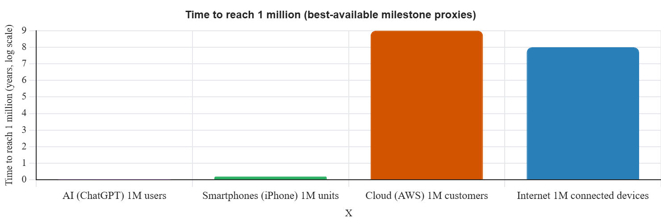
Public adoption rate
AI -> 5 days = 1M users
Smartphones -> 74 days = 1M units sold
Internet -> 8 years = 1M connected devices
Cloud Computing -> 9 years = 1M customers
78% of organizations use AI, and 66% of people use AI regularly. AI adoption is accelerating faster than the introduction of the internet, mobile devices, and cloud services.

Slide 7
Implementing AI across your institution

Slide 8

Leadership Team Discussion
Assess AI usage and comfort levels. Identify areas for efficiency improvement.

Slide 9
Ai governance
AI Policy
Create guidelines for AI usage. Provide policies and training to team members.
AI Governance Solution
Establish frameworks for managing AI systems. Discuss with your MSP (Managed Service Provider).
Implement a Solution that can monitor, record, and maintain AI prompts.
Licensing
Acquire licenses for AI tools. Protect institution entered prompts and data usage in training new models.

Slide 10

Fear of replacement
Institutions should responsibly communicate to their employees that AI is not intended to replace them, but rather to enhance their efficiency and enable them to concentrate on more complex scenarios. The combination of employees and AI has the potential to increase productivity tenfold.

Slide 11
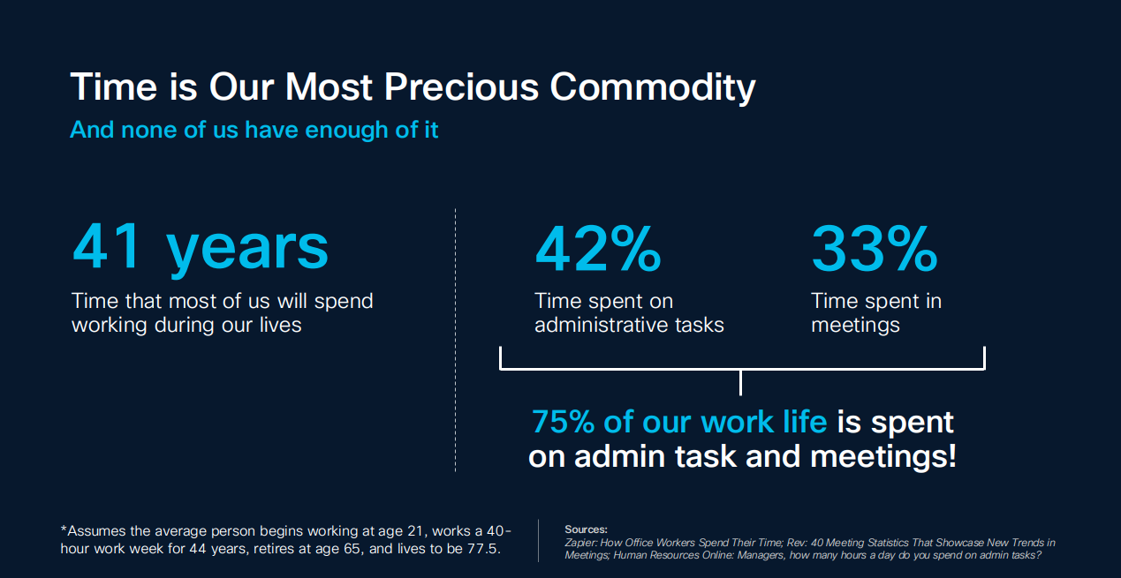

Slide 12
Potential task improvements
Summarize meeting minutes
Help build presentations
Help build institution policies
Clean up email content
Call Center Automations
Member call analysis
Increase accessibility of CU knowledge database
Assist with Loan Application completeness
Outbound calling for Loss Prevention
Build trend reports from Core System data
Review (RFP) Contracts for potential gaps or issues

Slide 13
Ai usage concerns

Slide 14
Cybersecurity risk
Phishing
AI-powered phishing attacks that target individuals and organizations.
Deepfake
AI-generated fraudulent videos or images posing significant security challenges.
Data Leakage
The exposure of sensitive information due to vulnerabilities in AI systems.
Data Poisoning
The deliberate manipulation of AI training data to skew results.

Slide 15
Hallucinations and unattended consequences
Bullying
Autonomous agents unexpected aggressive responses during human interactions.
Commercial Race
Adding advertisements or erotic role-play to AI generated responses.
Hallucinations
Instances where AI produces incorrect or misleading information, impacting decision-making processes.

Slide 16
Cognitive offloading
Cognitive offloading is the act of using external tools (like smartphones, AI assistants, or search engines) to store or process information instead of relying on our own memory. While this can increase efficiency, it can also lead to:
Reduced memorization: We don’t feel the need to memorize phone numbers, directions, or facts because we know we can retrieve them instantly.
Shallower encoding: When we expect to access information later, we tend to encode it less deeply in our brains, making it harder to recall without the tool.
Dependence on devices: Over time, we become reliant on technology for even simple tasks, which can weaken our natural memory skills.

Slide 17
Positives of artificial intelligence

Slide 18
Improve employee productivity
Increase Efficiency
AI automates tasks and enhances productivity.
Vast Knowledge Database
AI provides access to extensive information, enabling comprehensive analysis, summarization, and trend discovery across large datasets.
Data and Content Inspections
AI assists in reviewing and ensuring the quality of data and content, aiding team members in identifying trends and detecting anomalous information.

Slide 19
In conclusion
AI has swept across the world and is making significant progress in the business landscape. As leaders, it’s important to thoughtfully and strategically integrate AI into your operations. Some vendors may exaggerate AI’s capabilities and its potential return on investment (ROI), so having a clear implementation plan and criteria for what constitutes a successful outcome is essential.

Slide 20

Q & A

