Slide 1

Political and Legislative Update
August 2026 – Georgia Credit Union Executive Association Meeting

Slide 2
State (Georgia) - Legislative
New Legislation/Regulation:
Trusted Contact/Transaction Holds
Litigation Financing Parity, Crypto ATM
Unclaimed Property/Escheatment Shifts
Bankruptcy Exemption Increase
Gift Card Theft Penalties (closed and open loop)
Foreclosure Shifts (HOA, Judicial Purchases)
AI Restrictions
On Horizon:
Taxation/Tax Exemption Pressures
Interchange Restrictions
Unauthorized Practice of Law
Intangible Tax?
Magic Timing?
Remote Online Notary
Electronic Titling Issues Resolved

Slide 3
Federal – Congress
Housing Bill Passage
NCUA
  New Leadership
Interchange Restrictions
  Multi-Prong Focus: Congress, State, Litigation, Regulations
Taxation
Bi-Partisan Focus on Fees
  Congress
  CFPB
Stable Coin/Crypto
CTRs – Needs a Champion
CUSO Investment Cap

Slide 4
Political Shifts
Turnover: Federal
Turnover: State
Balance of Power?

Slide 5
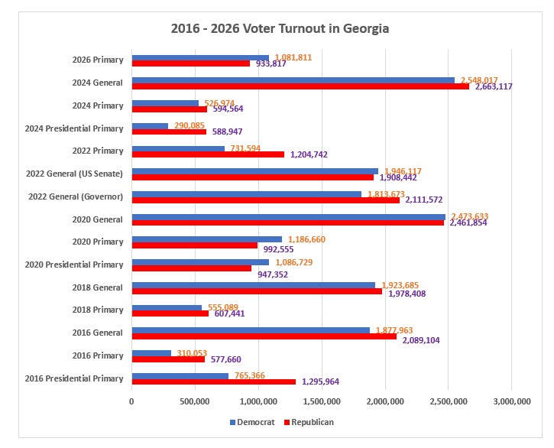
Voter Turnout Trends in Georgia

